Slide 1
News Articles Recommendation
Submitted by - Arch Desai, Sohil Parsana, Jay Shah

Slide 2
Motivation
Reading the news online has exploded as the web provides access to millions of news sources from around the world. The sheer volume of articles can be overwhelming to readers. A key challenge of news service website is help users to find news articles that are interesting to read. This is advantageous to both users and news service, as it enables the user to rapidly find what he or she needs and the news service to help retain and increase customer base.
Notes:
Motivation : As we know there are thousands of sources available online from we can read news articles. These articles have wide range of topics and sometimes this can be overwhelming to readers. A key challenge of news service providers is to help user filter news article according to user’s interests. This can be advantageous to both users and news providers as users get to read what they like as well as news providers can retain and increase their customer base.

Slide 3
Objective
Objective of the project is to build a hybrid-filtering personalized news articles recommendation system which can suggest articles from popular news service providers based on reading history of twitter users who share similar interests (Collaborative filtering) and content similarity of the article and user’s tweets (Content-based filtering).
This system can be very helpful to Online News Providers to target right news articles to right users.
Notes:
Our project objective is to build a hybrid-filtering personalized news article recommendation system which will suggest articles based on user’s activity on Twitter.

Slide 4
But Why Twitter?
Statistics
74% of Twitter users say they use the network to get their news.
500 million tweets are sent each day.
24% of US adults use Twitter.
How Twitter can be used?
Based on user’s tweets we can know user’s interests and can recommend personalized news articles which user would share on Twitter. This can increase news articles and news service’s popularity.

Slide 5
Project Flow
Collect active Twitter users’ data
Analyze users’ tweets
Cluster users according to their interests
Perform sentiment analysis and topic modeling
Collect and analyze news articles
Get user’s Twitter handle & Recommend news articles

Slide 6
Collect active Twitter users’ data
As a first step, the engine identifies readers with similar news interests based on their behavior of retweeting articles posted on Twitter. (Library : Tweepy)
The flow of collecting active users’ data:
Get Twitter users who retweet tweets of New York Times, Bloomberg, Washington Post. We identify them as active news readers.
Create a popularity Index
Popularity = Number of Followers / Number of Friends
Filter users based on their twitter activity and popularity
Collect information from Twitter profiles of these filtered users
Notes:
First we need to train our algorithm and for that we need lots of data. We scraped Twitter using Tweepy library for that.

Slide 7



Collect active Twitter users’ data - 2
Popular News Twitter Accounts
Active News Readers
Notes:
This is just a visual representation of how we are collecting data.

Slide 8
2. Analyze users’ Tweets
The tweets contains URLs, Usernames, non-english words, punctuations and numbers. Sometimes whole tweets are in different languages. To get information from tweets, preprocessing is important. (Library : NLTK )
Preprocessing:
Clean tweets
Removal of URLs, Usernames, numbers, non-english words, punctuations
Tokenize tweets
Process of breaking stream of textual content into words
Remove Stop words
Stop words: Most common words in a languages e.g the, is, am, are, there

Slide 9
Stemming and Lemmatization
Both of these are text normalization techniques used to reduce inflectional forms and sometimes derivationally related forms of a word to a common base form.
Stemming : Chops off words without any context (PortStemmer)
walking : walk, smiled : smile, houses : house
Lemmatization : Finds the lemma of words with the use of a vocabulary and morphological analysis of words (WordNetLemmatizer)
better : good, are : be, ran : run
Difference:
Caring - Car : Stemming
Caring - Care : Lemmatization
Notes:
Inflectional : modification of a word

Slide 10
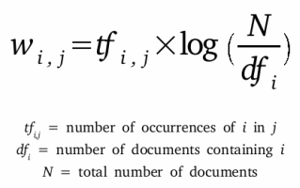
3. Cluster users according to their interests
We can cluster users based on their similarity of interests retrieved from their tweets and that requires vectorized representation of tweets.
Find TF-IDF matrix (Library : TfidfVectorizer from sklearn)
TF-IDF stands for Term Frequency- Inverse Document Frequency
TF : Gives frequency of words in each user’s tweets
IDF : Calculates the weight of rare words across all users’ tweets. The words that occur rarely in the corpus have a high IDF score.
Notes:
Then we created clusters of users but we cannot perform clustering on words and for that we converted words into vectorized form using Tf-idf matrix. Tf-idf stands for….

Slide 11
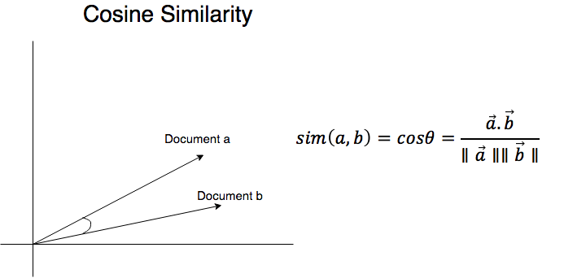
TF-IDF is a weight that ranks the importance of a term in its contextual document corpus.
Perform K-means clustering to cluster users based on tf-idf matrix.
To reduce the dimension of Tf-Idf matrix we define error term, distance matrix
Distance Matrix = 1 - Cosine Similarity of users’ tweets
Cosine similarity = (dot product of two vectors) / (product of vectors’ magnitudes)
The cosine of the angle between the vectors is a good indicator of similarity
Reduce dimension matrix using multi-dimension-scaling. (Library: Skleran’s MDS)

Slide 12
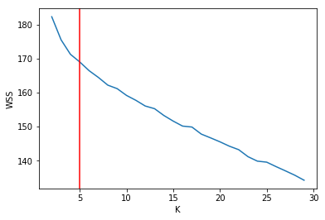
Selection of optimal K with Elbow Method
The elbow method, in which the sum of squares at each number of clusters is calculated and graphed, and the user looks for a change of slope from steep to shallow (an elbow) to determine the optimal number of clusters.

Slide 13
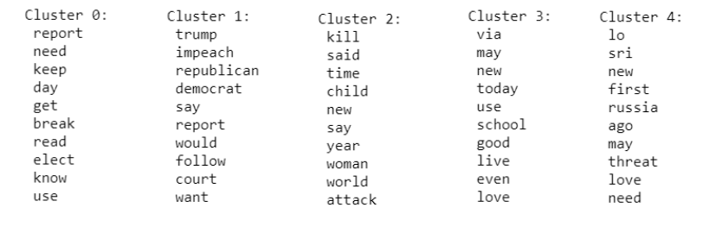
We created 5 clusters and top words in 5 clusters are shown below.
Earth Day
Trump News
Terrorist Attack
Daily Top News
World News

Slide 14
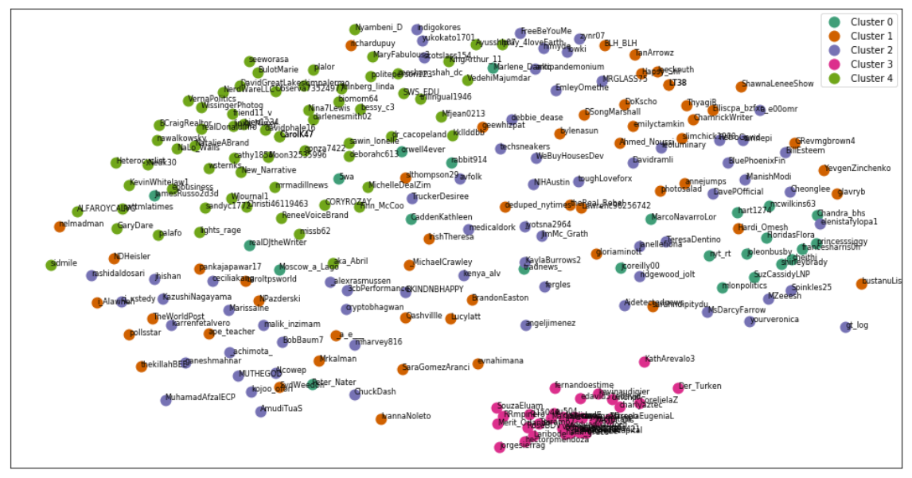
Cluster of Users

Slide 15



4. Perform Sentiment Analysis and Topic Modelling
Sentiment analysis -Computational study of opinions, sentiments, evaluations, attitudes, appraisal, affects, views, emotions, subjectivity, etc., expressed in text.
It is also called opinion mining
We have used pretrained model from Textblob library that gives two results:
Subjectivity and Polarity
Polarity is score between [-1,1], where 0 indicates neutral, +1 indicates a very positive sentiment and -1 represents a very negative sentiment.
Subjectivity is score between [0,1], where 0.0 is very objective and 1.0 is very subjective. Subjective sentence expresses some personal feelings, views, beliefs, opinions, allegations, desires, beliefs, suspicions, and speculations where as Objective sentences are factual.
Notes:
Trained on Wordnet
Uses Pattern Analyzer
All WordNet synsets automatically annotated for degrees of positivity, negativity, and neutrality/objectiveness

Slide 16
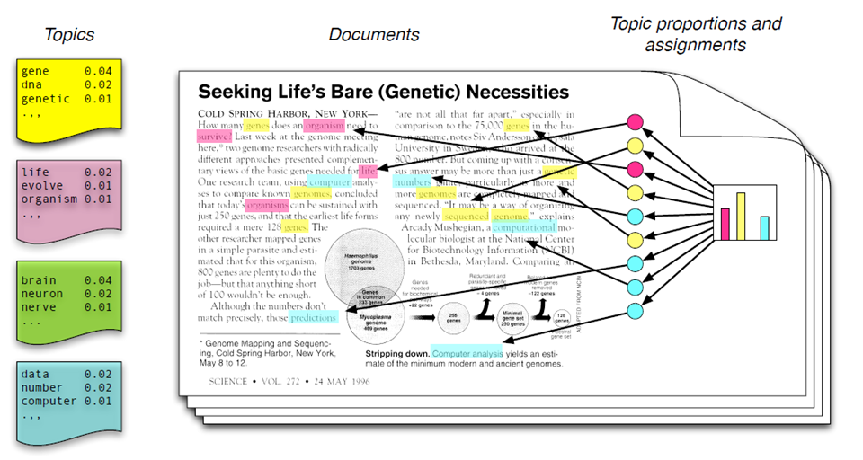
Topic Modelling Motivation
Notes:
Each topic is a distribution of words; each document is a mixture of corpus-wide topics; and each word is drawn from one of those topics.
In reality, we only observe documents. The other structures are hidden variables. Our goal to infer the hidden variables.

Slide 17
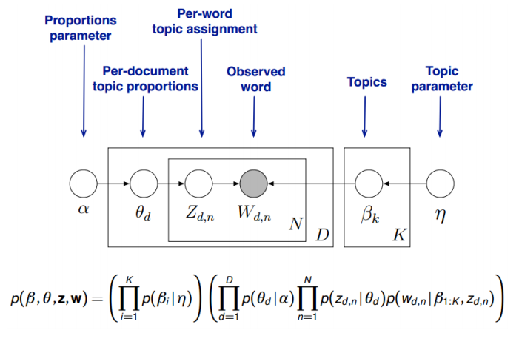
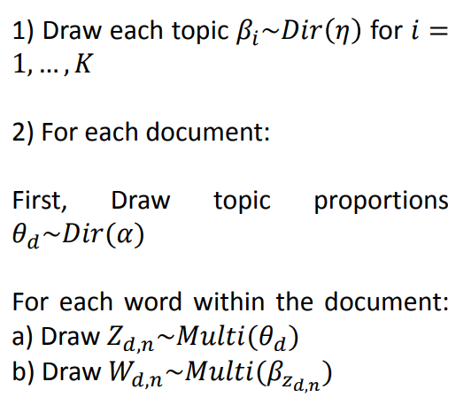
Model Description
Notes:
Per-document topics proportions 𝜃_𝑑 is a multinomial distribution, which is generated from Dirichlet distribution parameterized by 𝛼.
Smilarly, topics 𝛽_𝑘 is also a multinomial distribution, which is generated from Dirichlet distribution parameterized by 𝜂.
For each word 𝑛, its topic 𝑍_(𝑑,𝑛) is drawn from document topic proportions 𝜃_𝑑.
Then, we draw the word 𝑊_(𝑑,𝑛) from the topic 𝛽_𝑘, where 𝑘=𝑍_(𝑑,𝑛).
Model intractable

Slide 20
Application in our problem
Using LDA Mallet model for topic modelling of each individual cluster. It is more efficient than Gensim’s LDA package requiring O(corpus).
Tuning of number of topic for each cluster accomplished using the coherence measure: using C_v measure (combining normalized pointwise similarity and cosine similarity)
Notes:
EM, Variational EM, Full Gibbs estimating LDA generative model
The best performing coherence measure (the most left column) is a new combination found by systematic study of the conguration space of coherence measures. This measure (CV ) combines the indirect cosine measure with the NPMI and the boolean sliding window. This combination has been overlooked so far in the literature. Also, the best direct coherence measure (CP ) found by our study is a new combination.

Slide 21
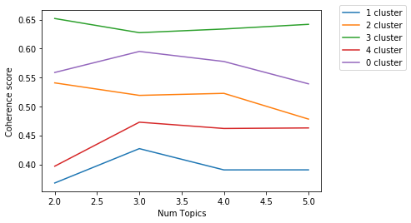
Topic Model Visualization
Interactive Viz-1
Interactive Viz-2
Notes:
To use the visualization tool, click a circle in the left panel to select a topic, and the bar chart in the right panel will display the 30 most relevant terms for the selected topic, where we define the relevance of a term to a topic, given a weight parameter, 0 ≤ λ ≤ 1, as λ log(p(term | topic)) + (1 - λ) log(p(term | topic)/p(term)). The red bars represent the frequency of a term in a given topic, (proportional to p(term | topic)), and the blue bars represent a term's frequency across the entire corpus, (proportional to p(term)). Change the value of λ to adjust the term rankings -- small values of λ (near 0) highlight potentially rare, but exclusive terms for the selected topic, and large values of λ (near 1) highlight frequent, but not necessarily exclusive, terms for the selected topic. A user study described in our paper suggested that setting λ near 0.6 aids users in topic interpretation, although we expect this to vary across topics and data sets (hence our tool, which allows you to flexiby adjust λ).

Slide 22
5. Collect articles
We scraped recent news articles from different news channels using python package : Newspaper3k.
They have different categories so we can train our algorithm using all topics. And our algorithm can satisfy wide range of topics giving good and similar recommendations.
Notes:
Newspaper is a Python module used for extracting and parsing newspaper articles. Newspaper use advance algorithms with web scrapping to extract all the useful text from a website. It works amazingly well on online newspapers websites.

Slide 23
6. Get User’s Twitter Handle and Recommend News articles
There are two main types of collaborative filtering: user-based and item-based. Note that the two are entirely symmetric (or more precisely the transpose of each other)
Content-based Filtering
Based on the tweets of a user, we can identify his or her interests.
Based on the similarity of user’s interests and news article’s content/tags/headlines, we can recommend news articles.
The approach has intuitive appeal: If a user posts ten tweets having the word “Clinton,” user would probably like future “Clinton”-tagged news articles.
Example- Amazon( Recommendation based on recently viwed items)
Shortcomings of this method:
Since, rare words have large weightage in the algorithm it sometimes degrades the performance.
For example, if a user’s one tweet contains word “election”, he would get recommendation of news articles tagged election as it is a rare word and higher weightage is given to it.

Slide 24
(2) Collaborative Filtering
Based on tweets of a user, we can identify a cluster in which user belongs to.
Based on the topics of each cluster, we can recommend news article to a user
For example, If a user tweets about election, he or she can be assigned to a cluster of users who have read and retweeted news articles that our user isn't aware of on the topic of election and we can recommend it to a user
Example - Amazon (Customer who bought this item also bought)
Shortcoming:
this approach fails at recommending newly-published, unexplored articles: articles that are relevant to groups of readers but hadn’t yet been read by any reader in that group.

Slide 25
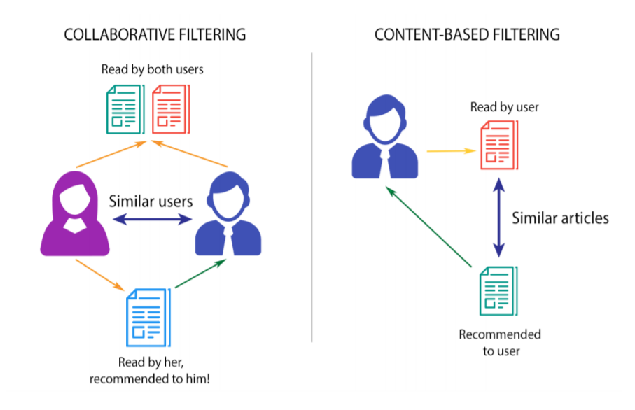

Slide 26
Hybrid-filtering
In these methods, a combination of both recommendation algorithms are used to maximize advantage and minimize the drawbacks of both algorithms. The different methods for hybridization are shown below.
Method | Description
Weighted | The scores (or votes) of several recommendation techniques are combined together to produce a single recommendation
Switching | The system switches between recommendation techniques depending on the current situation.For example, in earlier phases, one might use a knowledge-based recommender system to avoid cold-start issues
Mixed | Recommendations from several different recommenders are presented at the same time
Feature combination | Features from different recommendation data sources are thrown together into a single recommendation algorithm. Similarity with Stacking

Slide 27
Our Approach (Feature Combination)
We get the news articles based on the topics of a cluster in which user belongs to.
We compare the content of news articles to the content of a user’s tweets and find similarity
We rank the articles based on similarity with users personal interest and recommend to users.

Slide 28
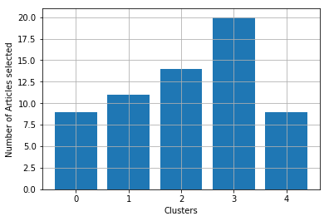
Collaborative Filtering
 |  | Example Recommended Article
 | Cluster | CNN | NYTimes
Earth Day | 0 | https://www.cnn.com/2019/04/24/entertainment/top-credit-cards-for-those-with-excellent-credit? | https://www.nytimes.com/2019/04/24/opinion/california-wildfire-climate.html
Trump News | 1 | https://www.cnn.com/2019/04/24/politics/presidential-tax-returns-states-2020-trump/index.html | http://www.nytimes.com/2019/04/24/us/politics/russia-2020-election-trump.html#commentsContainer
Terrorist Attack | 2 | https://www.cnn.com/2019/04/24/investing/ford-rivian/index.html | http://www.nytimes.com/interactive/2019/04/23/world/asia/sri-lanka-isis-religious-ethnic-tensions-map.html
Entertainment News | 3 | https://www.cnn.com/2019/01/30/business/kohls-weight-watchers/index.html | http://www.nytimes.com/2019/04/24/sports/damian-lillard-portland-trail-blazers.html
World News | 4 | https://www.cnn.com/2019/04/15/australia/australia-racism-media-christchurch-attack-intl/index.html | http://www.nytimes.com/2019/04/24/opinion/rwanda-genocide.html

Slide 29
Hybrid Filtering
Here we added weight to our recommendation personalized by individual user
After user has been classified into clusters, we will calculate similarity score of user’s interest with identified articles within each clusters.
Weight = Topic Modeling Normalized Prob(80%) + Sentiment Score (20%)
Based on this weight criteria we will rank the articles personalized for each user.

Slide 30
Final Pipeline
Calculate TF-IDF from the corpus
Top Articles of the similar Cluster
Get Tweets data from Twitter
Weighted top K Articles
Rank Articles with similarity with users past tweets
User’s Twitter Handle
Process Tweets
Compare with precomputed Clusters

Slide 31

Project Flow Covered
Collect active Twitter users’ data
Analyze users’ tweets
Cluster users according to their interests
Perform sentiment analysis and topic modeling
Collect and analyze news articles
Get user’s Twitter handle & Recommend news articles

Slide 32
Current Challenges:
How to recommend news articles to a user if he or she does not have any tweets? (Cold Start Problem)
How to evaluate the performance of a recommendation system?
Topic Modelling and retrieving users’ data are bottlenecks as they need to be updated very frequently.
Scale this model on large dataset

Slide 33
Thank You.

